Slide 1
Digital Portfolio
STUDENT NAME: A.akash
REGISTER NO AND NMID:222404548/A5227430ADDA97885C44884145780501
DEPARTMENT: bsc.software application
COLLEGE: COLLEGE/ UNIVERSITY:a.m jain college

Slide 2
PROJECT TITLE DIGITAL PORTFOLIO

Slide 3


AGENDA
Problem Statement
Project Overview
End Users
Tools and Technologies
Portfolio design and Layout
Features and Functionality
Results and Screenshots
Conclusion
Github Link
3/21/2024 Annual Review

Slide 4
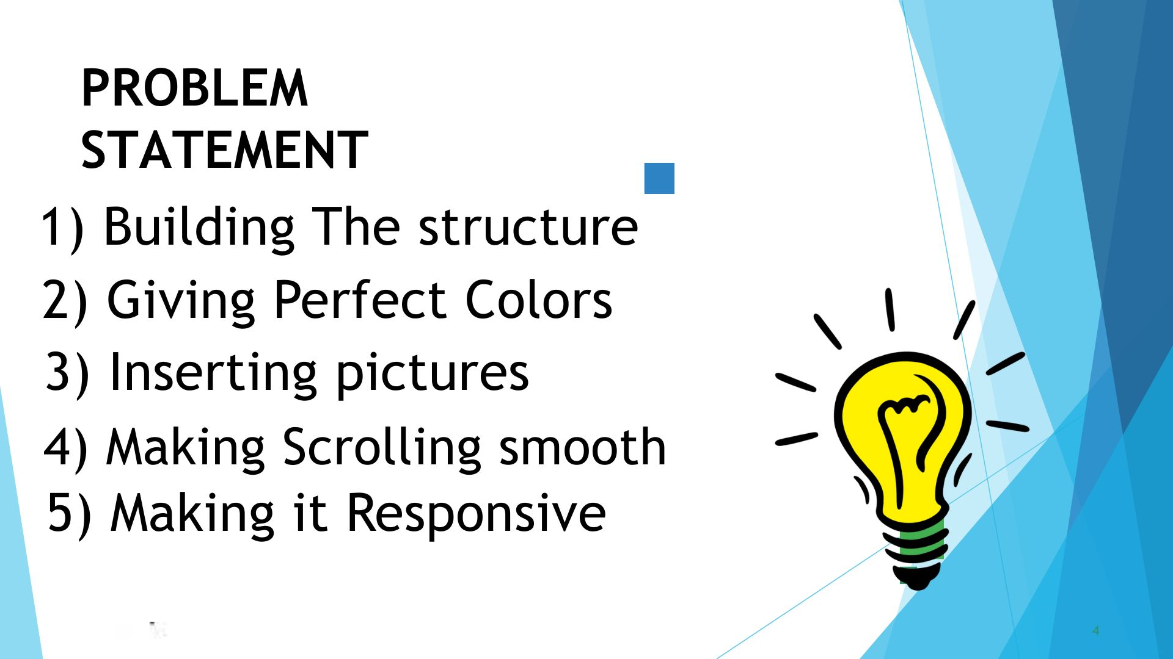

PROBLEM STATEMENT

Slide 5


PROJECT OVERVIEW

Slide 6
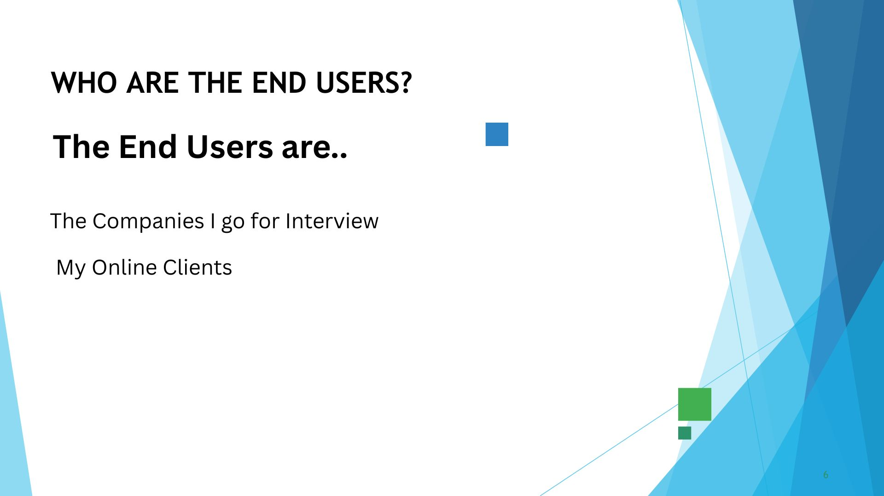

WHO ARE THE END USERS?

Slide 7


TOOLS AND TECHNIQUES

Slide 8
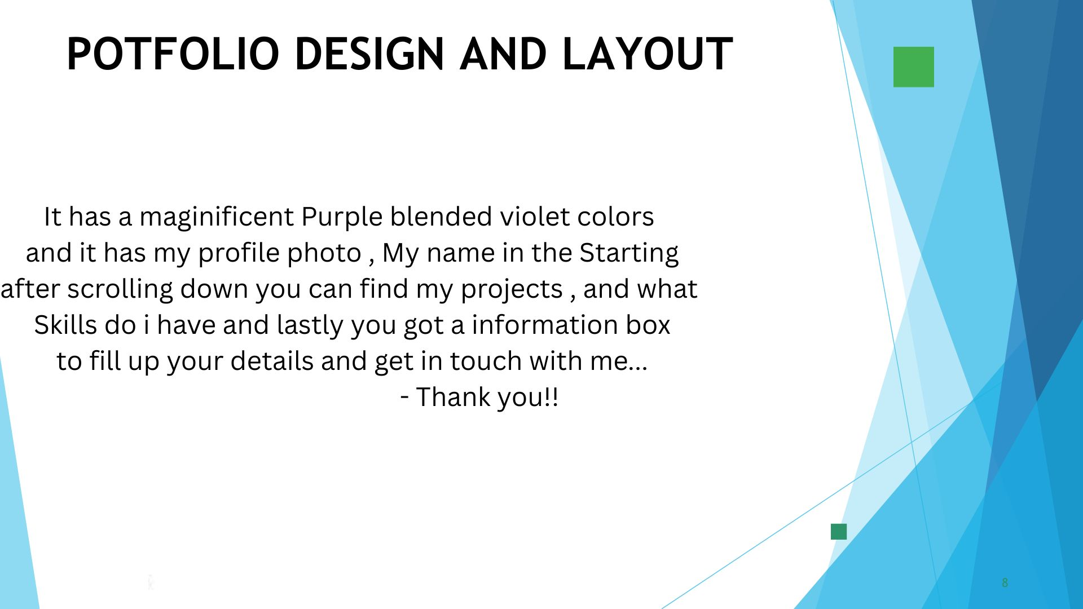
POTFOLIO DESIGN AND LAYOUT
8

Slide 9
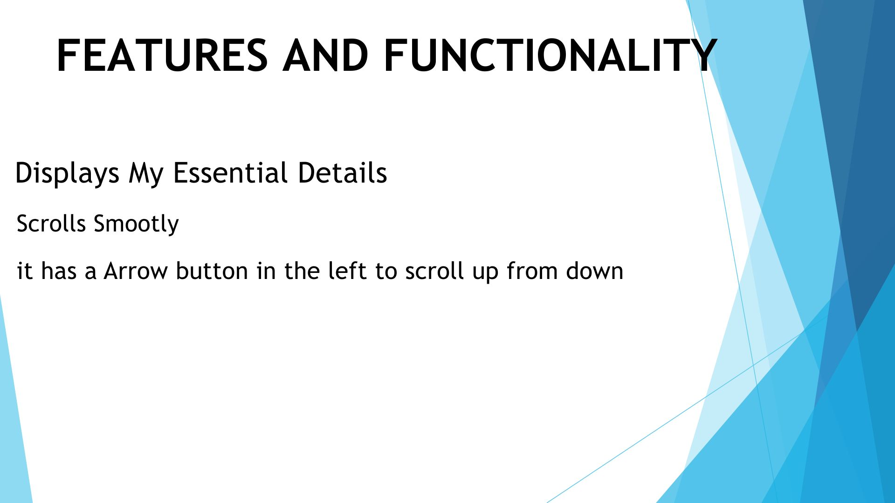
FEATURES AND FUNCTIONALITY

Slide 10
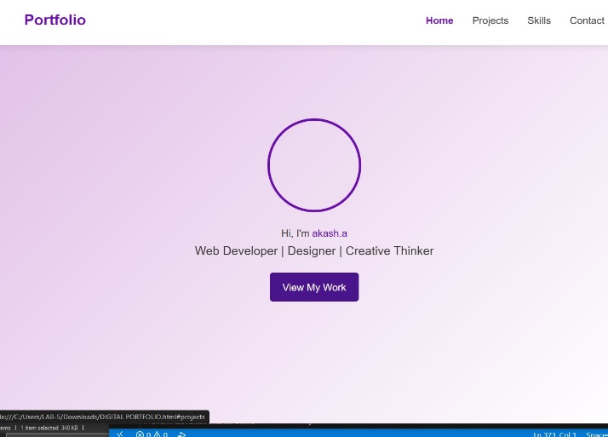
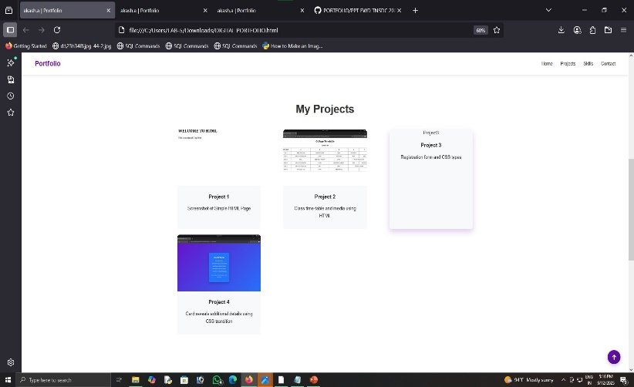

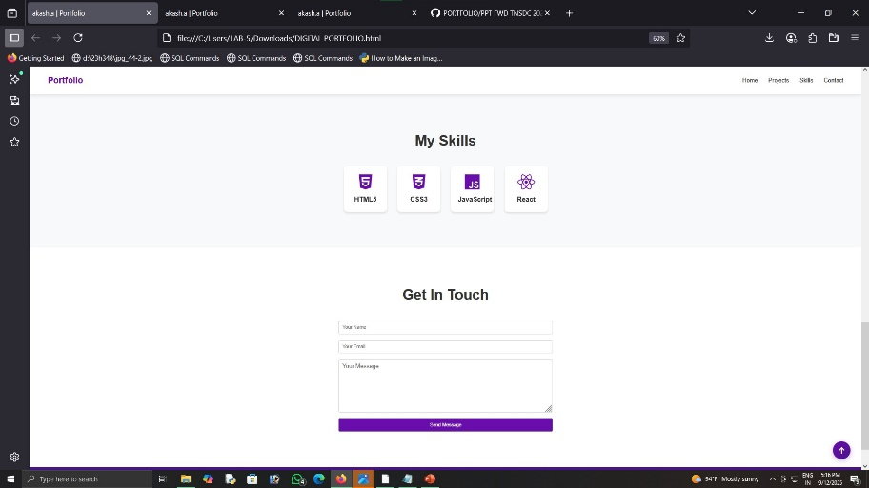
RESULTS AND SCREENSHOTS
3/21/2024 Annual Review
10

Slide 11

CONCLUSION
Server link: https://github.com/AKASH7534/PORTFOLIO.git
Deployment link: https://akash7534.github.io/PORTFOLIO/
11

